Slide 1
Machine Translation

Slide 2
Outline
Introduction
Types of MT
History of Machine Translation
Existing Machine Translation System
Approaches to MT
Translation Unit

Slide 3
Introduction to Machine Translation

Slide 4
Translation?
The process of transforming natural language text from one language (source language) into a meaningfully equivalent text in the second language (target language) is called translation.
Ref: [M.A Khan (1995)]
Source text ----------------> Target text
Source language
Target language
Translation by human being

Slide 5
Translation…
Note:
The closeness of the target text into the source text is an idealism which is not always achievable.
The closer the meaning of the two text to each other, the more accurate will be the translation and the higher will be the quality of translation.

Slide 6
Human translator
A person who is responsible for the translation of one natural language text (or speech) to another natural language text (or speech) is called human translator
Also called technical translator

Slide 7
Types of human translator
Language specialist:
A specialist of some field, e.g. engineering etc., but having specialties in one or several foreign languages
Linguists:
Know more than one languages from the very beginning
A specialist of languages
Trained person:
Get education of more than one languages in some educational institute

Slide 8
Problems with a human translator
Shortage
Can get tried and bored
Expensive/Charge fee
Not available everywhere
Can die
Translate same word/sentence differently in different times i.e. inconsistent.

Slide 9
Need of a machine translation system
To overcome the limitations of human translators, we need machine translation systems

Slide 10
Machine translation…
Definition 1:
Machine Translation (MT) is the task of automatically converting one natural language into another, preserving the meaning of the input text, and producing fluent text in the output language.
Ref: [http://nlp.stanford.edu/projects/mt.shtml,]
Source text ----------------> Target text
Source language
Target language
Translation by machine

Slide 11
Types of MT

Slide 12
Types of MT
Direct/ Dictionary based MT
Transfer-based MT
Interlingual MT

Slide 13
Direct or Dictionary based MT
The words are translated as a dictionary does i.e. word by word usually without much correlation of meaning between them.
Dictionary lookups may be done with or without morphological analysis
While this approach to MT is probably the least sophisticated, dictionary-based machine translation is ideally suitable for the translation of long lists of phrases e.g. inventories or simple catalogs of products and services.

Slide 14
Transfer-based MT
It is currently one of the most widely used methods of MT.
Transfer MT breaks translation into three steps:
analysis of the source language text to determine its grammatical structure,
transfer of the resulting structure to a structure suitable for generating text in the target language,
finally generation of the text.
Transfer-based MT systems are thus capable of using knowledge of the source and target languages

Slide 16
Interlingual MT
One of the classic approaches to machine translation.
The source language is transferred into an interlingua, i.e., an abstract language-independent representation.
The target language is then generated from the interlingua.

Slide 17
History of MT

Slide 18
History of machine translation….
The early years 1950s—1960s
Warren Weaver proposal
The first proposals for machine translation using computers were put forward by Warren Weaver, in his July 1949.
Georgetown experiment:
The first work of translation was published in 1954 in the Georgetown experiment involving fully automatic translation of more than 60 Russian sentences into English.
The experiment was a great success and the authors claimed that machine translation would be used in translations within three or five years.
However, the real progress was very slow
Ref:[http://www.thelanguagetranslation.com/machine-translation.html]

Slide 19
History of machine translation….
1966-- Cut off funding
Reasons for giving off research in MT
Expensive memory
Low size of memory
Slower processing speed of processor
Low quality softwares to process natural language text
Large amount of time needed to processes limited text
Result
Funding was stopped for further research on machine translation projects

Slide 20
History of machine translation....
1970 and early 1980: Revival of machine translation
Development of personal computer:
However, starting in the late 1970s and beginning 1980s, with the impact of personal computer revolution, with the increase in computational power, more interest began to be shown in statistical models for machine translation.
Large and less expensive memory and computers:
There was growth in the use of machine translation as a result of the beginning of less expensive , large memory size and more powerful computers.
In 1970, the Systran system was installed for the United States Air Force and subsequently in 1976 by the Commission of the European Communities
The METEO System, was installed in Canada in 1977 to translate weather forecasts from English to French
Ref: [http://www.thelanguagetranslation.com/machine-translation.html]

Slide 21
History of machine translation....
1980s
Research during the 1980s typically relied on translation through some variety of intermediary linguistic representation involving morphological, syntactic, and semantic analysis.
Statistical Machine Translation (SMT) approach was introduced by IBM
Example-based Machine Translation (EBMT) approach was introduces by Makoto Nagao.

Slide 22
History of machine translation....
Early 1990s
Speech translation
During the 1990s, research began into speech translation after the successes in speech recognition and speech synthesis
Online translation systems
With the 1990s, the importance of machine translation further increased and the use of "translation engines" on the Internet to allow for translation of websites and email languages started
Ref: [http://www.thelanguagetranslation.com/machine-translation.html]

Slide 23
History of machine translation....
Examples of online translation systems
SYSTRAN
http://www.systranet.com/translate
Google translate
http://www.translate.google.com
AltaVista's Babelfish
http://babelfish.yahoo.com/
Microsoft translator
http://www.microsofttranslator.com/

Slide 24
History of machine translation….
Recent research: beyond 1990s
Work is continued in:
statistical machine translation
example-based machine translation
speech translation
research has focused on moving from specific-domain systems to generic-domain translation systems
In the United States (STR-DUST) solutions for automatically translating Parliamentary speeches and broadcast news have been developed
More recently, the French-German project Quaero investigates possibilities to make use of machine translations for a multi-lingual internet. The project seeks to translate not only webpages, but also videos and audio files found on the internet
Ref [http://en.wikipedia.org/wiki/History_of_machine_translation]

Slide 25
Importance of machine translation
Provides Cheap, universal access to world’s online information regardless of original language.
Used in education, politics, business, trade, cultural study and media.
A combination of text+speech translation enables:
Two persons, that do not know each other language, to talk to each other on the telephone
Participants in a conferences, debates and discussion forum in international organization such as UNO, ECO etc to talk to each other.
The translation of films in film industry to other languages
To translate a spoken or written language to the signed language of deaf people

Slide 26
Problems in machine translation
Bilingual or multilingual dictionary design
Poly-semantic words of the source language
Problem of idiosyncrasies: no relevant word in target language
Order of words of the source and target language
No one-to-one correspondence between the words of the source and target language

Slide 27
Existing Machine Translation System

Slide 28
GETA
Group study for automatic translation”.
Initial name was CITA
It was developed in 1959 at CNRS (Centre national de la recherche scientifique) France
Initial objective of this was to translate the space messages of Russian into French

Slide 29
GETA (Cont..)
The translation process in GETA consist of three main stages
Analysis
Transfer
Generation

Slide 30
EUROTRA
Initiated in 1978 by European Community R&D program in MT
The EUROTRA project is the machine translation program of the European Community
The objective of this project is the creation of a small multilingual system

Slide 31
EUROTRA (Cont...)
Operated in a limited subject field and for a limited no. of text types
Served as a basis for industrial development
Consist of three main phases i.e. analysis, transfer and generation

Slide 32
DLT
Distributed language translation
Is a Dutch MT system
It was initiated by a Dutch engineer Toon Witkam in 1979
Consist of two main phases i.e.
Analysis and
Generation

Slide 33
DLT (Cont...)
This system use interlingua approach
Translate text from English into French

Slide 34
SUSY
This MT system was developed in the University of Saar (West Germany)
Based on the principles of multilinguality
Initially work began on Russian and German languages

Slide 35
SUSY (Cont...)
The system consist of three major components
Analysis
Transfer and
Generation
Nowadays, SUSY is called STS
Use for computer-aided translation

Slide 36
SYSTRAN
Developed in 1960s by Peter Toma
English into French and Italian
It was first used by U.S. Air Force
1988 it was working for 12 languages
This system is “hybrid ‘direct transfer’ system”
Means the system uses partly transfer strategy and partly direct

Slide 37
BABEL-Research
It is a group of researchers in the University of Brussels, Belgium
Funded by UNISYS
Translation of technical manual from one language into another
The languages involve are English, French, Dutch and German
Transfer architecture is used
The programming language use is Pascal

Slide 38
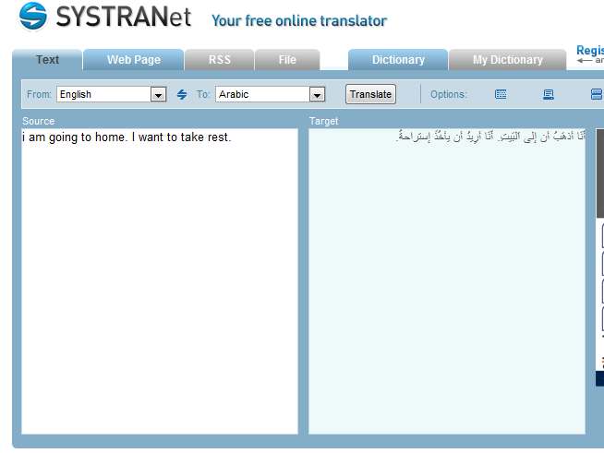
SYSTRAN system
http://www.systranet.com/translate

Slide 39
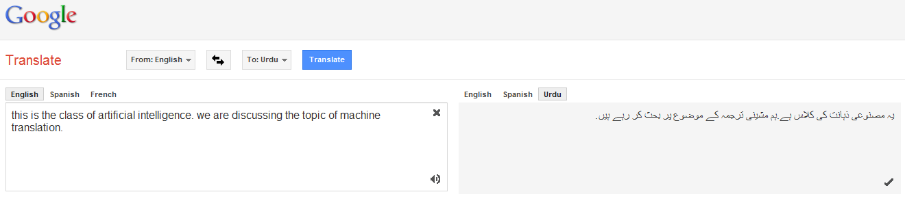
Google translate system
https://translate.google.com.pk/

Slide 40
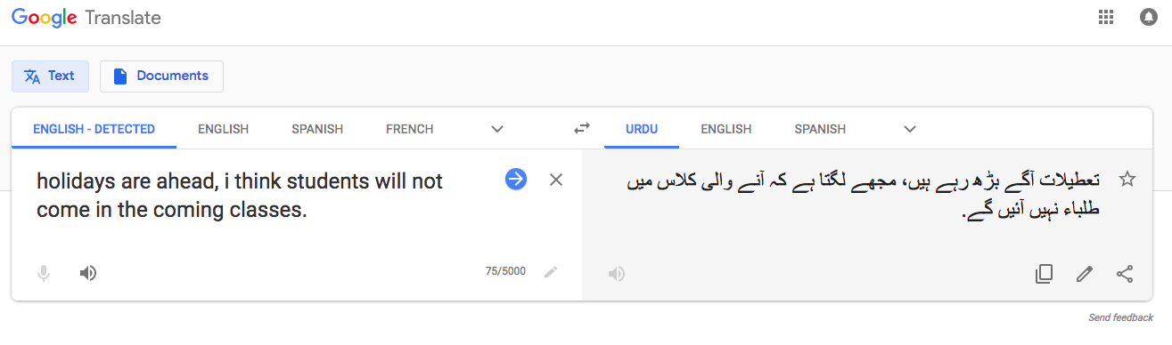
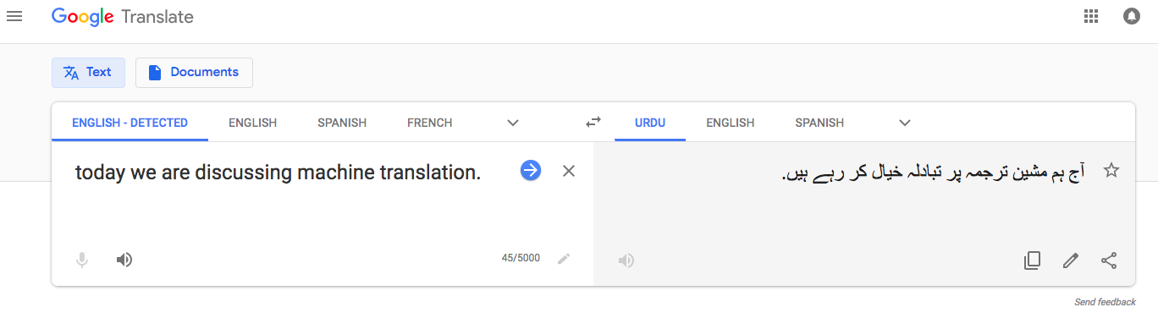
Example

Slide 41
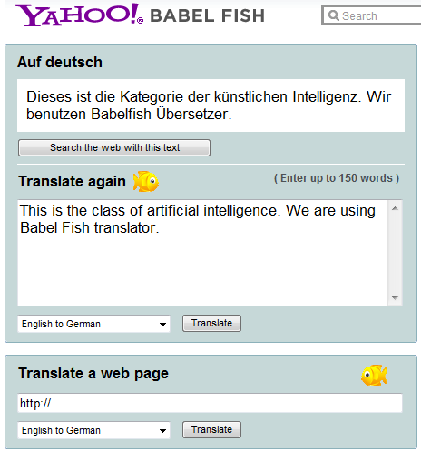
Yahoo Babel Fish system

Slide 42
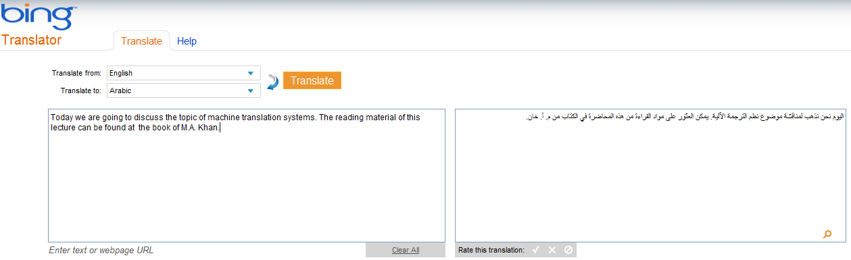
Microsoft translator

Slide 43
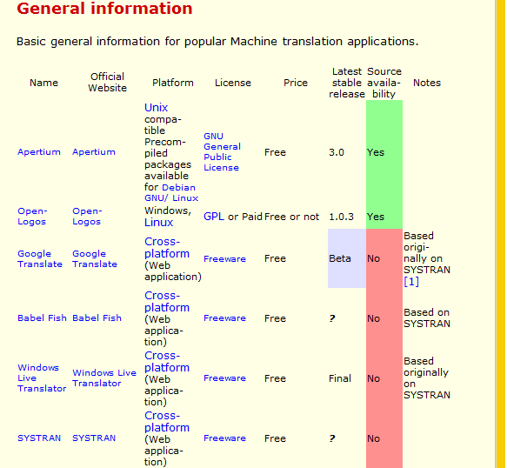
Other online machine translation systems

Slide 44
